Slide 1
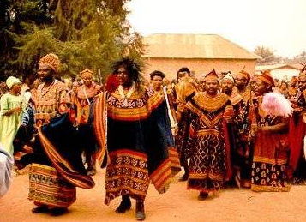
Traditional African Society

Slide 2
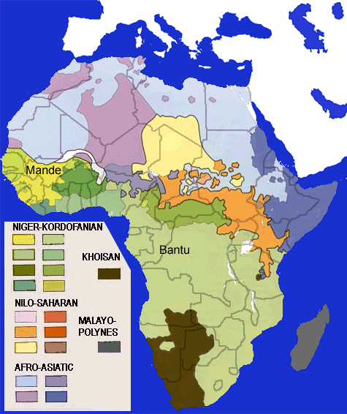
1000+ different languages; 1000+ different tribes

Slide 3
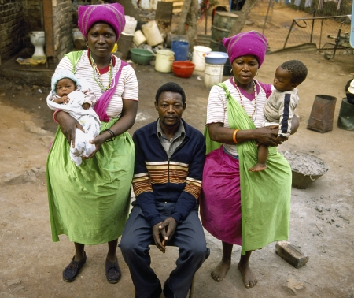
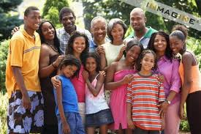
Traditional Family Structures - The basic family unit is:
The nuclear family =
parents & children living and working together as unit
Nuclear Family:
Many men have more than one wife
C
C
C
W
H
W
C
C
Extended Family:
U
GP
Cs
C
C
C
W
H
W
C
C
Cs
GP
A

Slide 4
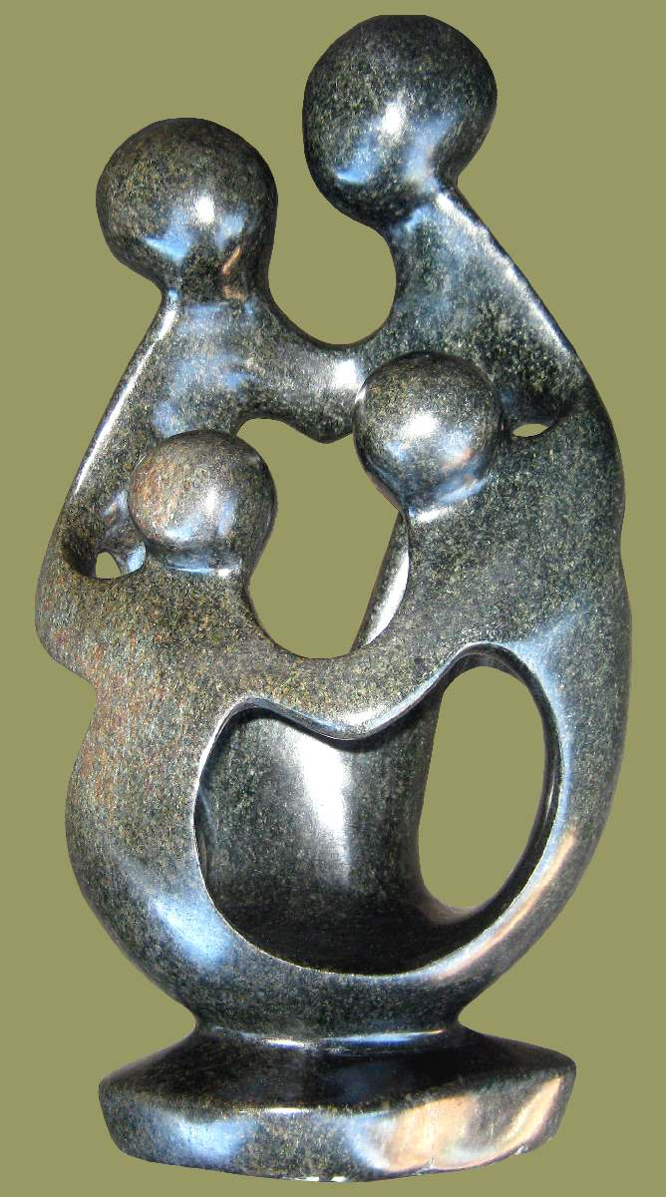
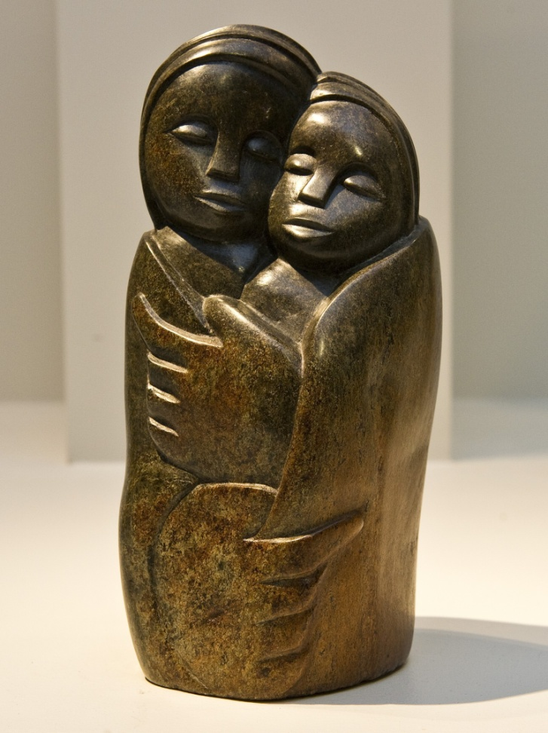
Traditional African Sculptures showing the importance of family

Slide 5
An African’s Identity
1. Nuclear Family
2. Extended Family
3. Age-Set
4. Clan
5. Lineage (ancestry) -
each family belongs to a lineage or group of households who claimed a common ancestor
TRIBE (communal living)

Slide 6
Common Traits or Characteristics of Traditional African Tribal Life
The good of the group comes ahead of the good of the individual.
All land is owned by the group.
Strong feeling of loyalty to the group.
Important ceremonies at different parts of a person’s life.
Special age and work associations.
Deep respect for ancestors.
Religion is an important part of everyday life.
Government is in the hands of the chiefs [kings].

Slide 7
Family Groups, Tanzania Artwork with a special purpose – showing the extended family group

Slide 8
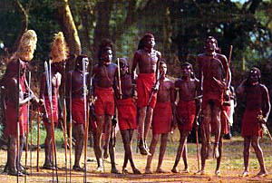
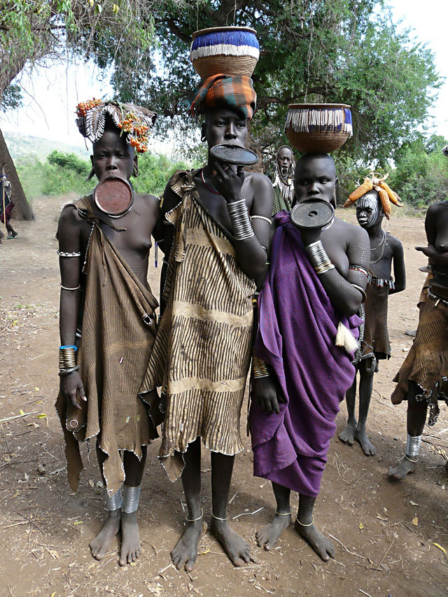
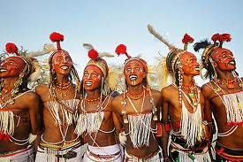
Mursi Tribe, Ethiopia
Masai Tribe, Kenya
Africa :
Tribe
Wodaabe-fula people of Sierra Leon

Slide 9
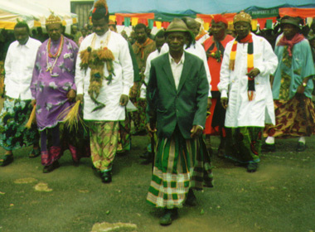
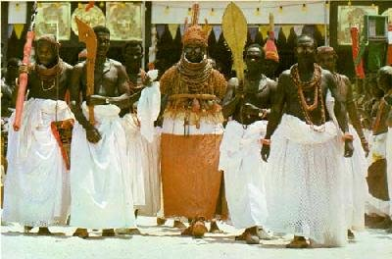
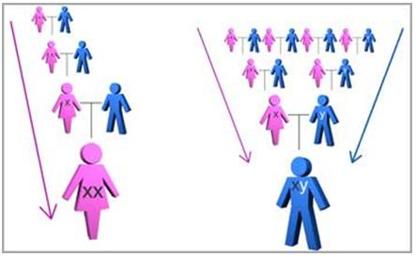
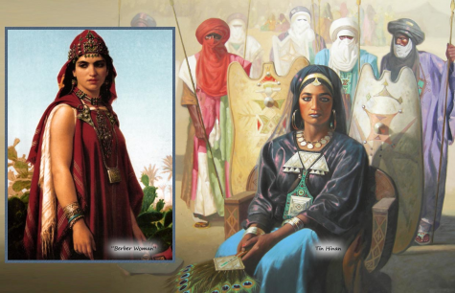
Some families are PATRILINEAL – family ties passed through father’s side
Traditionally, more African families were MATRILINEAL – family ties passed through mother’s side

Slide 10
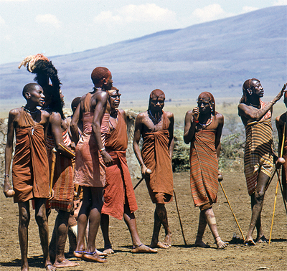
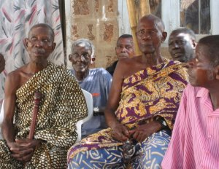
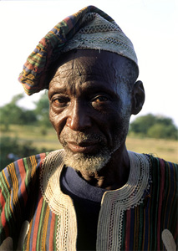
CONCENSUS –
Villages make decisions by consensus
a general agreement on decision
discuss opinions & options
wisdom of older men and women very important

Slide 11
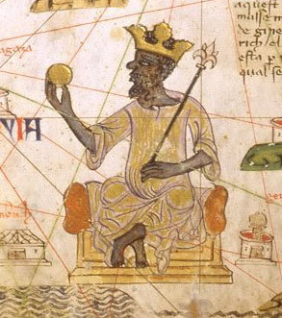
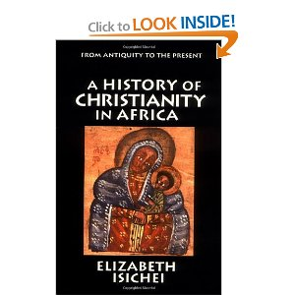
Religions in Africa
ISLAM → average is 45% of population → largest % in sub-Saharan countries.
CHRISTIANITY → 40%
Other Traditional Religions make up 15% of the population – this # was much higher before Christ (32 A.D. and Mohammed in 622 A.D.)

Slide 12
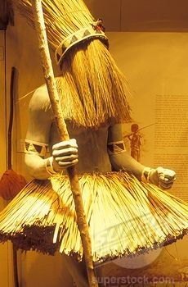
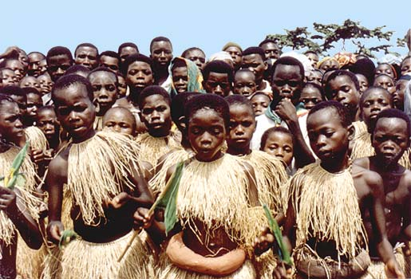
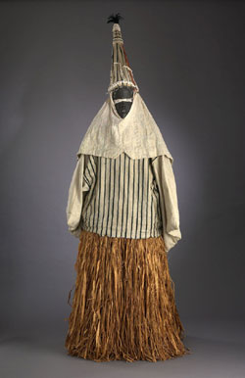
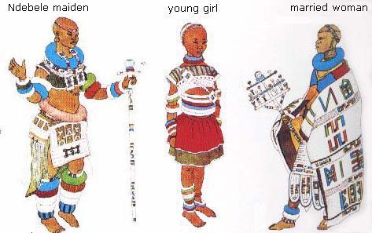
Initiation Costumes
Ceremonies initiate young men and women into adulthood

Slide 13
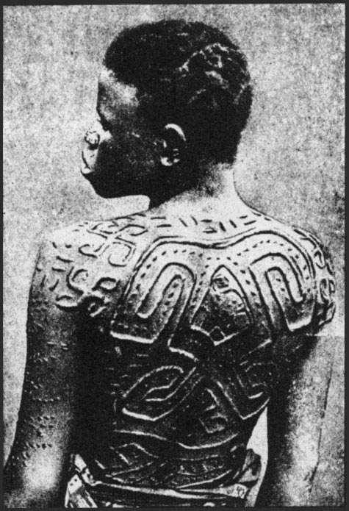
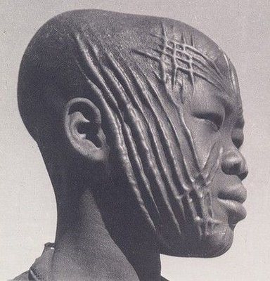
Mask With Head cloth, Zaire
Tribal Mark → scarification
There are aesthetic (beauty), religious, and social reasons for scarification. For example, scarification has been widely used by many African tribes to mark tribal association or stages of adulthood.

Slide 14
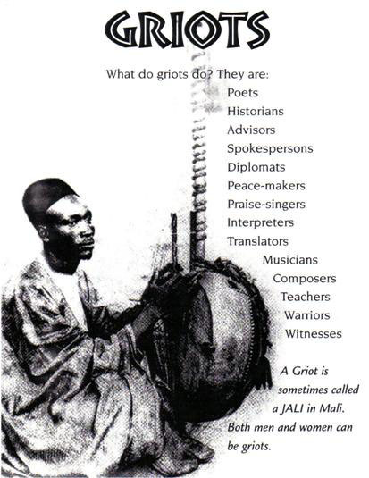
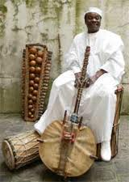
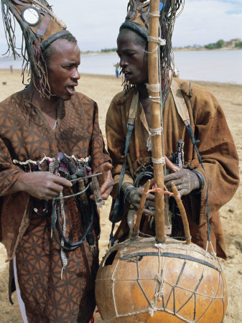
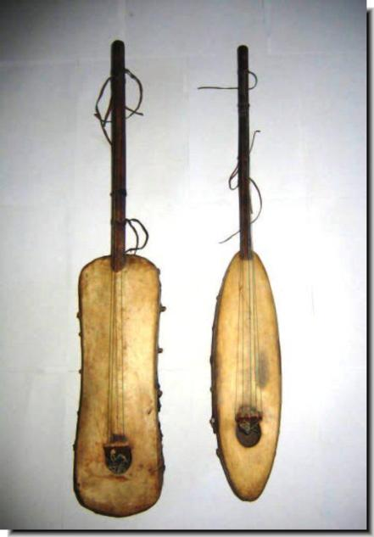
Griots – Storytellers
Most African tribes did not have a written language
oral tradition that goes back many centuries
told ancient stories such as epics and folktales
Preserved family & tribal histories
Told as a chant or song
Encouraged a sense of community

Slide 15
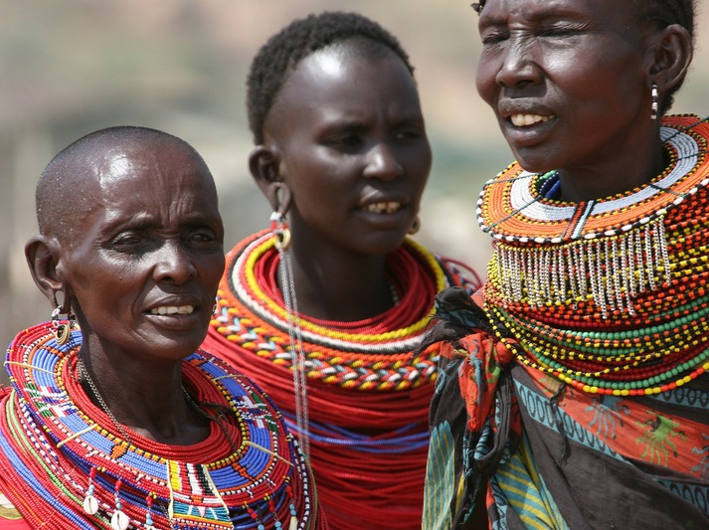
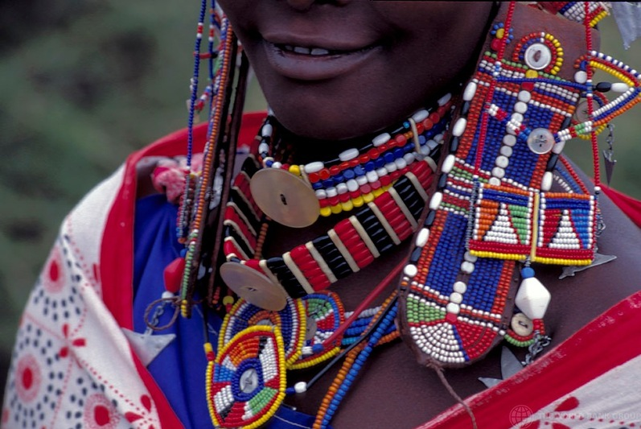
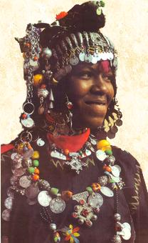
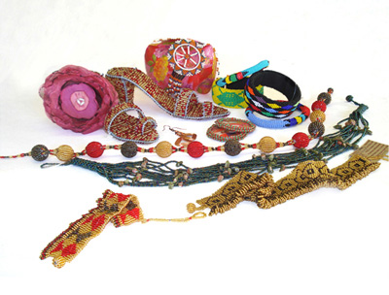
Traditional African Art – helped tribes develop a sense of community
Jewelry

Slide 16
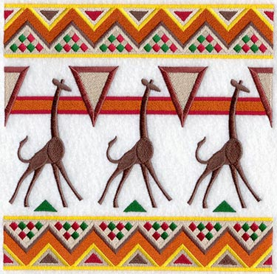
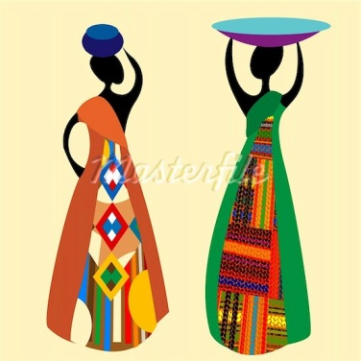
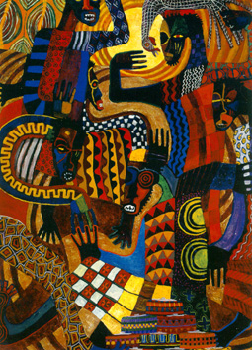
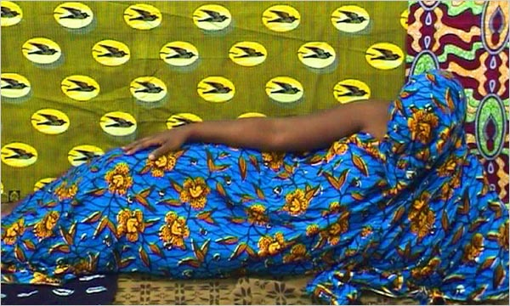
Traditional African Art Patterns

Slide 17
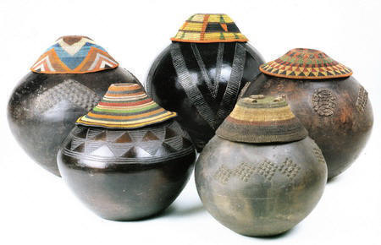
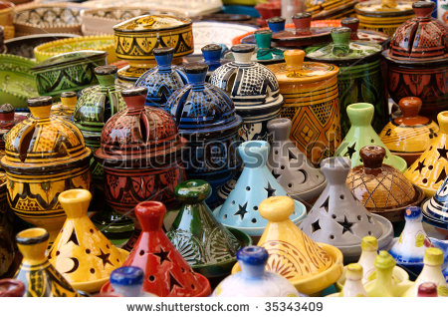
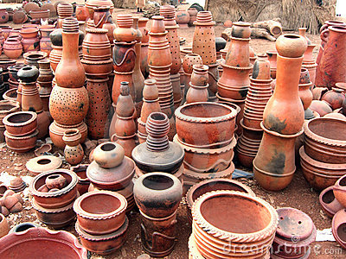
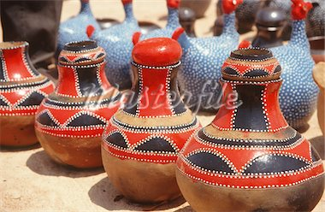
Traditional African Art - Pottery

Slide 18
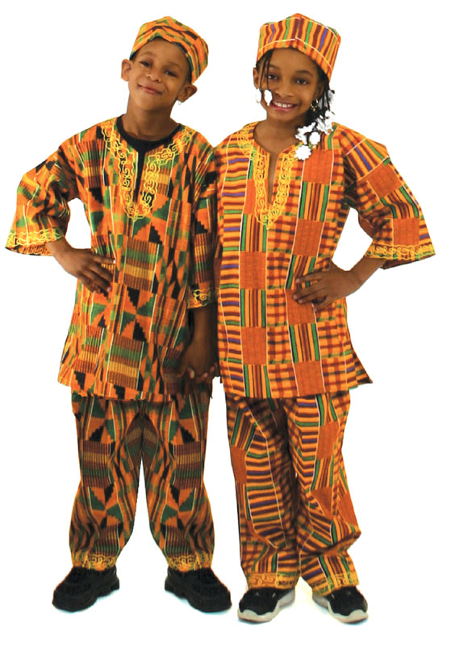
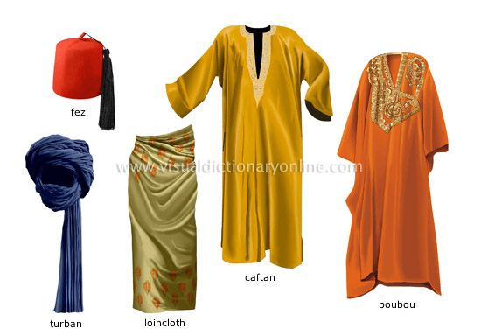
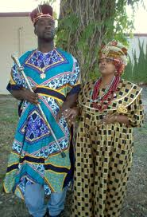
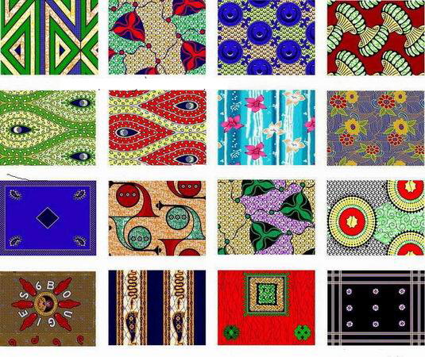
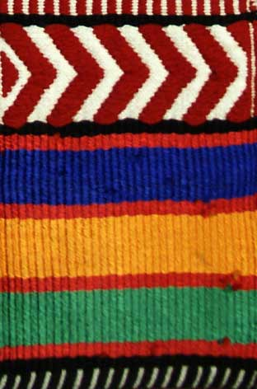
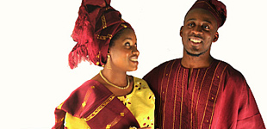
Traditional African Art – Cloth and Clothing

Slide 19
Problems of Tribalism Today
1. The tribe is more important than the nation.
2. Communication problems.
3. Inter-tribal warfare → civil wars.
4. Tribal favorites for government jobs:
Nepotism
Breaks down tribal traditions.
Urbanization:
Tribal intermingling on the job.

